Slide 1
Correlation Tensor Decomposition and Its Application in Spatial Imaging Data
GwangWoo Kim
July 29, 2021

Slide 2
Contents
1. Introduction
2. Preliminary
3. Methodology
4. Theoretical Results
5. Simulation Study
6. Conclusion

Slide 3

1. Introduction

Slide 4
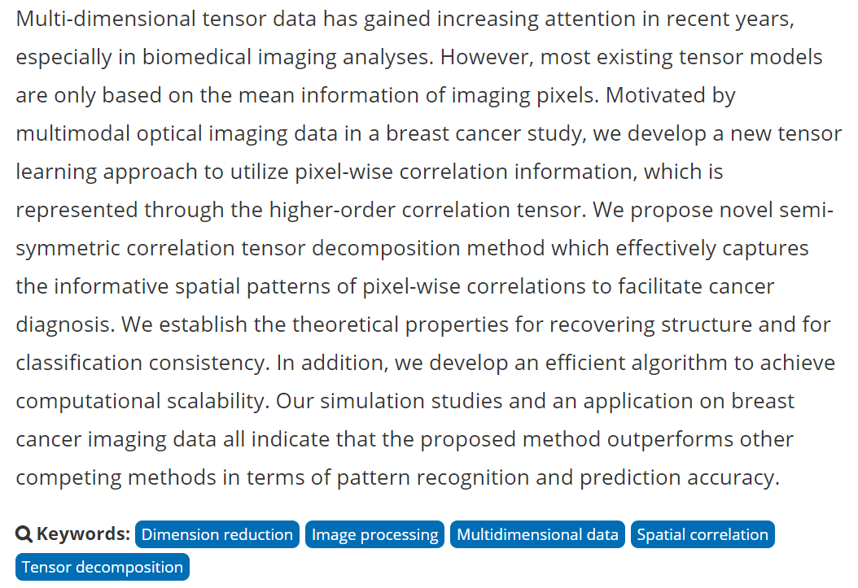
1. Introduction

Slide 5

1. Introduction

Slide 6

1. Introduction

Slide 7
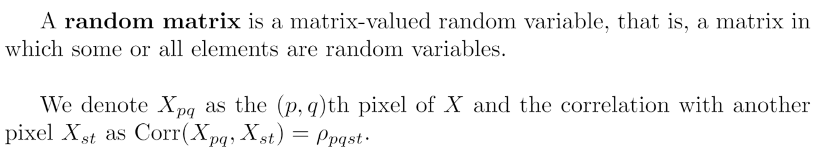
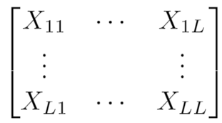
2. Preliminary

Slide 8

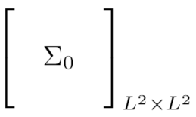
2. Preliminary

Slide 9
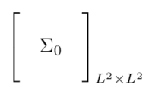


2. Preliminary
It cannot preserve the important spatial information (qualitative)
The number of parameters involved through vectorization is
(quantitative)

Slide 10
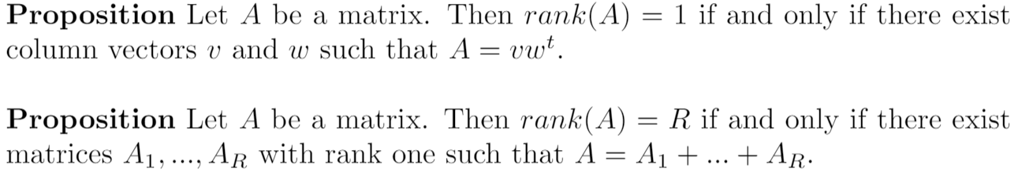
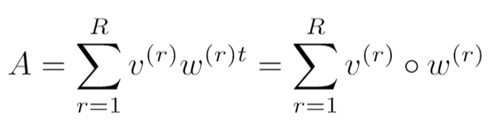
2. Preliminary

Slide 11
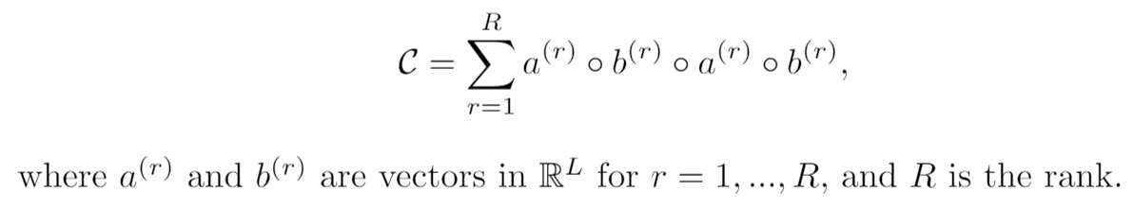

3. Methodology

Slide 12
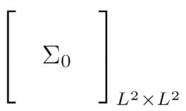
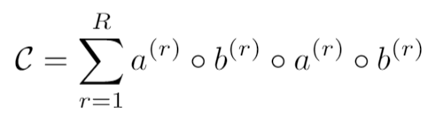

3. Methodology
It cannot preserve the important spatial information (qualitative)
It preserves the spatial information (See example)
The number of parameters involved through vectorization is (quantitative)
The number is reduced to

Slide 13
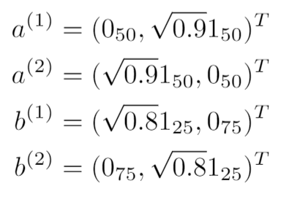
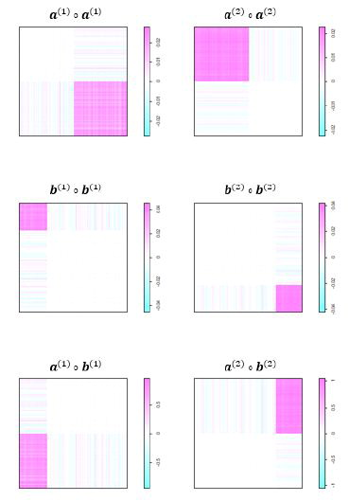
3. Methodology

Slide 14
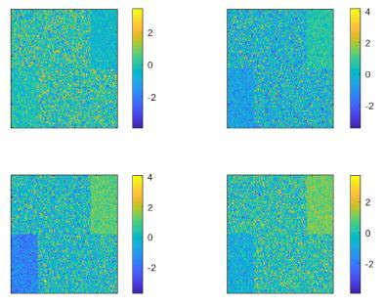
3. Methodology

Slide 15
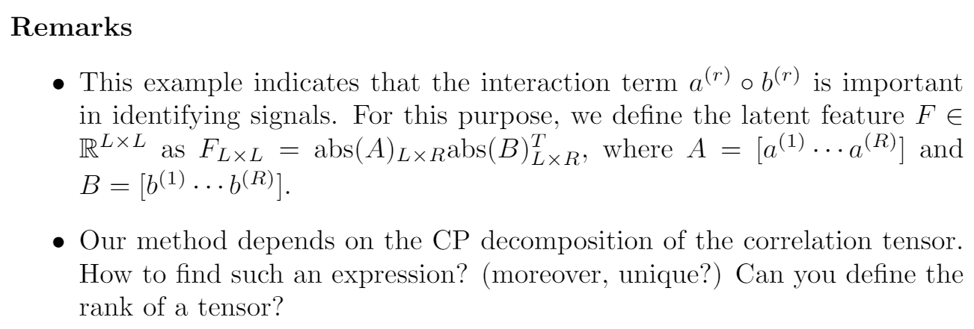
3. Methodology

Slide 16
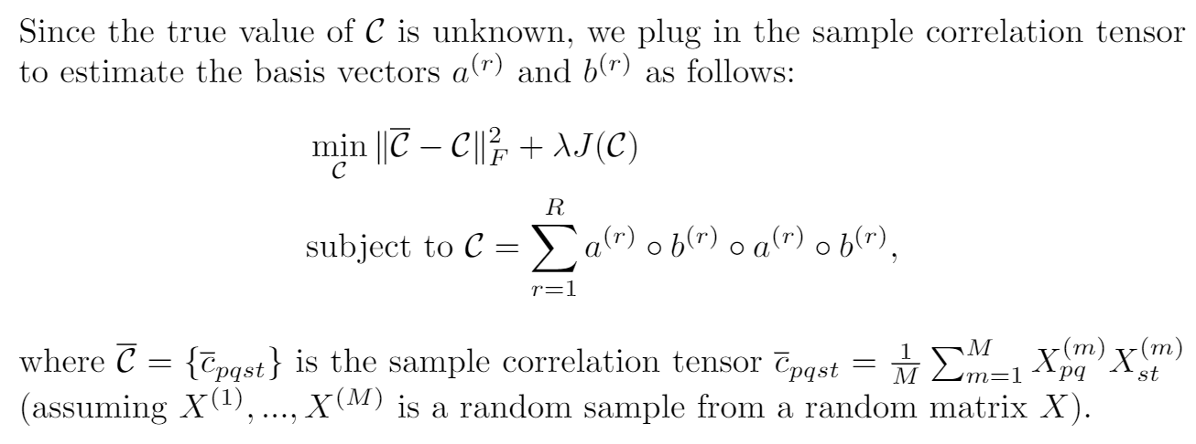
3. Methodology

Slide 17
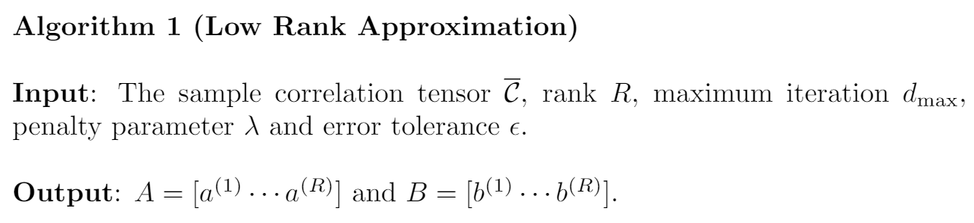
3. Methodology

Slide 18
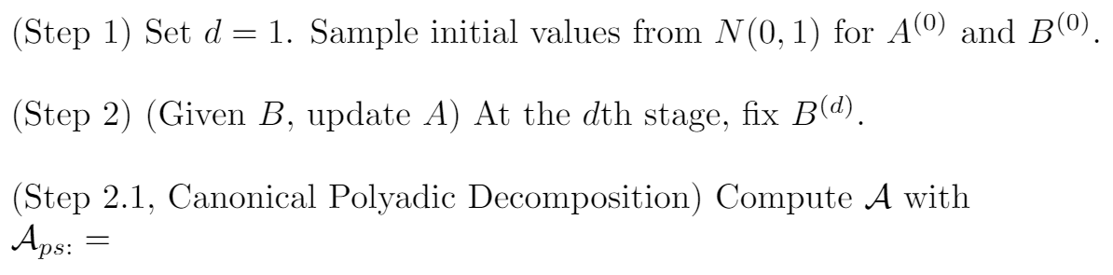
3. Methodology

Slide 19
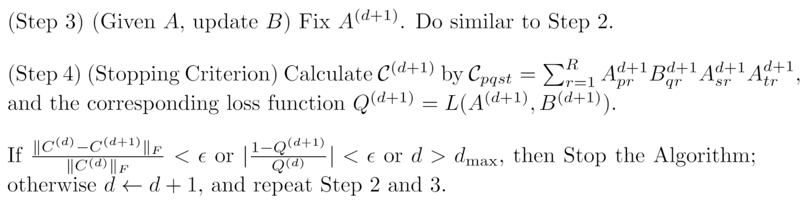
3. Methodology

Slide 20



3. Methodology
given A

Slide 21
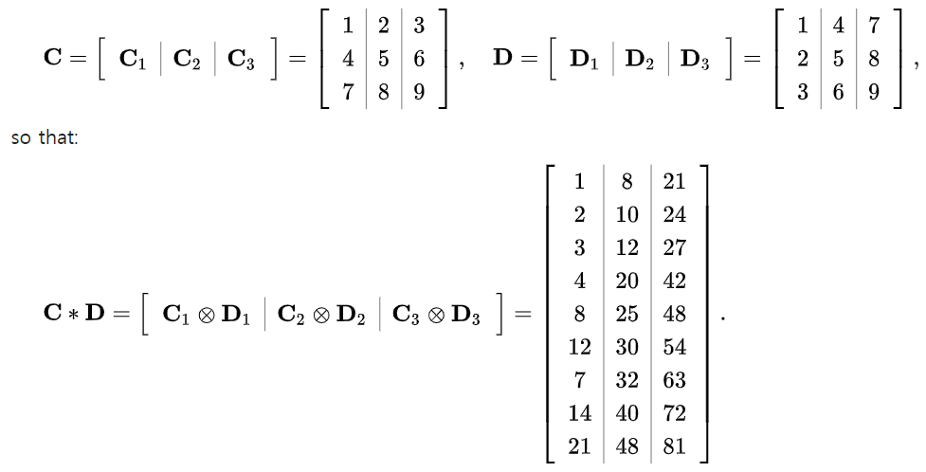
3. Methodology
Column-Wise Khatri-Rao Product

Slide 22
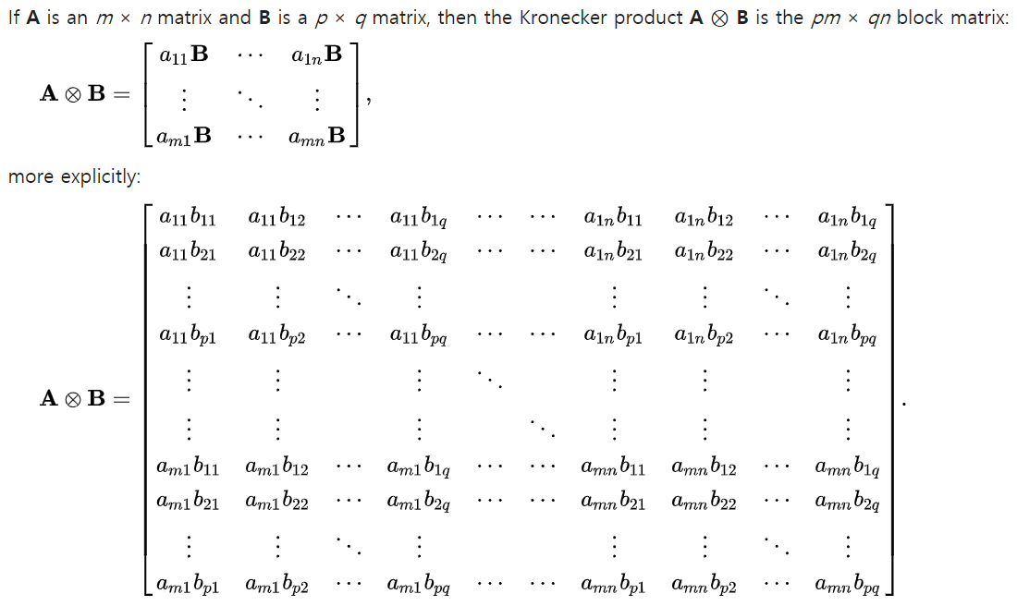
3. Methodology

Slide 23
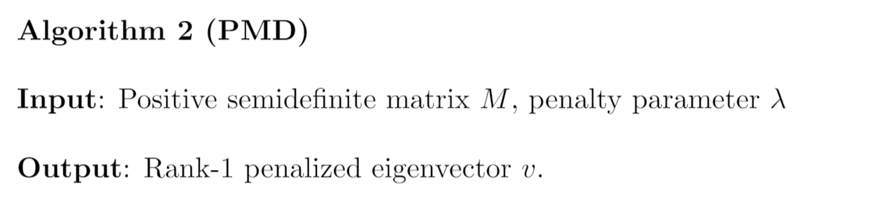
3. Methodology

Slide 24
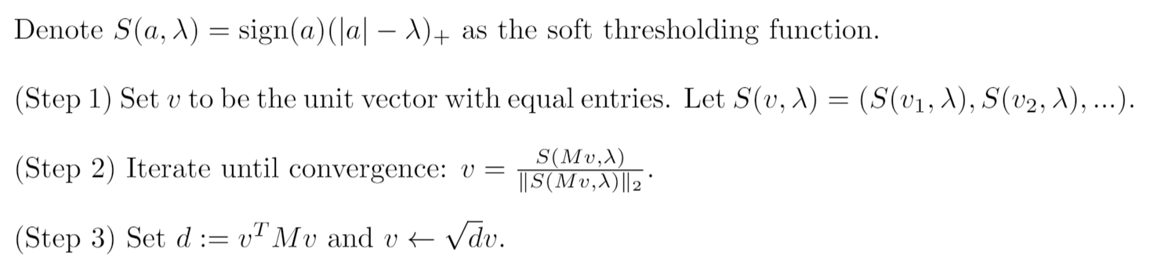
3. Methodology

Slide 25
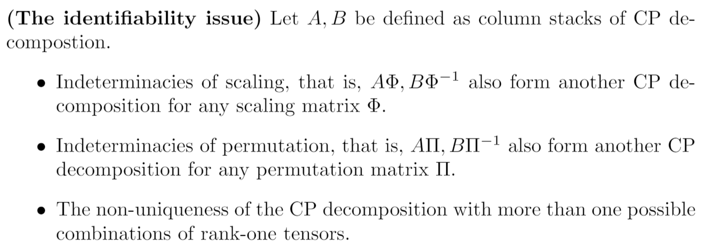
4. Theoretical Results

Slide 26
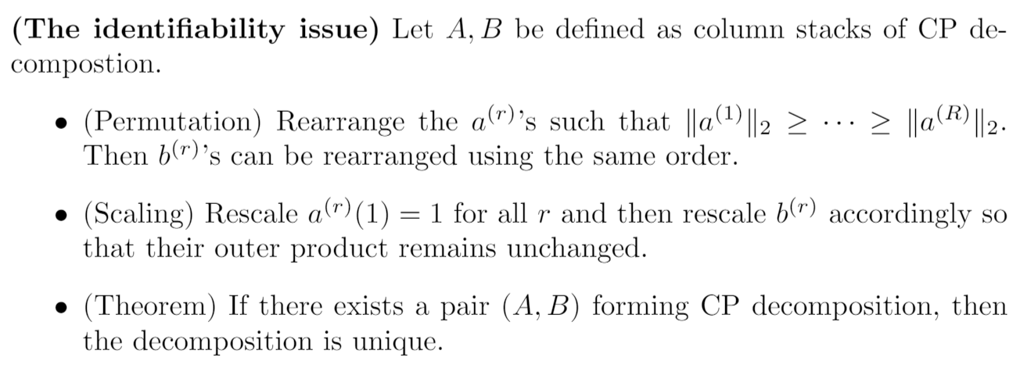
4. Theoretical Results

Slide 27
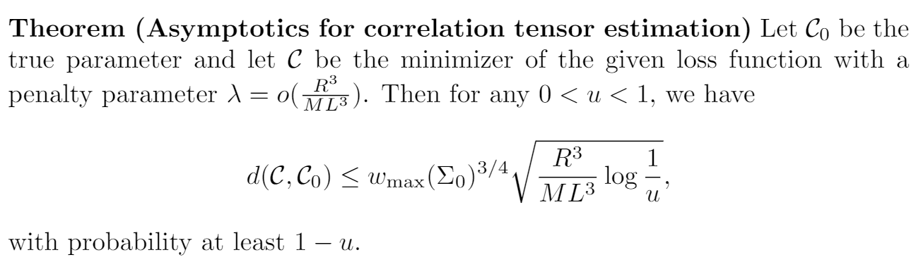
4. Theoretical Results

Slide 28
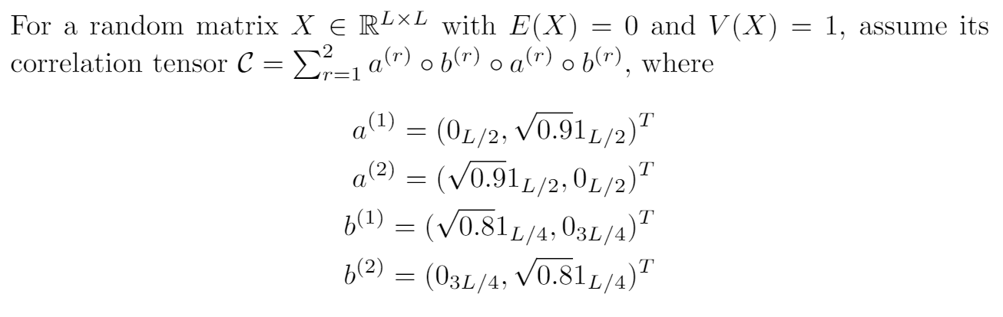
5. Simulation Study

Slide 29
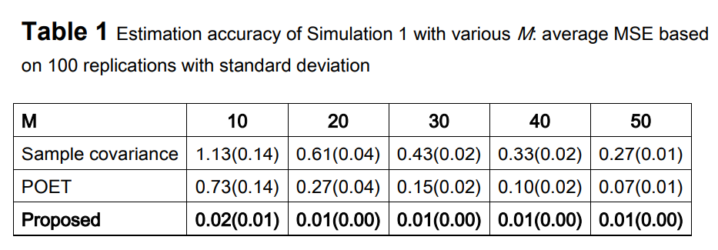
5. Simulation Study

Slide 30
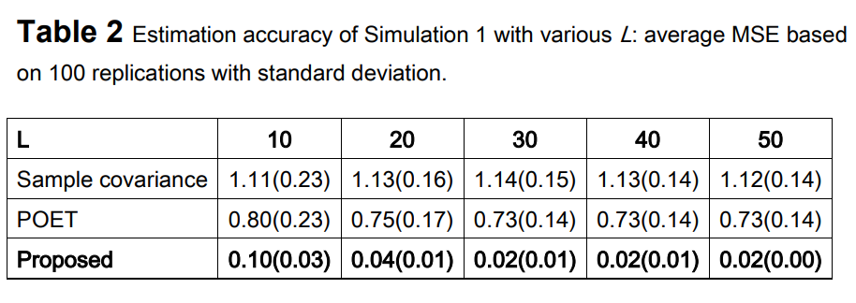
5. Simulation Study

Slide 31
6. Conclusion
1. We introduce the concept of correlation tensor and propose a tensor decomposition to achieve high estimation accuracy.
2. A major contribution of the proposed method is that we are able to preserve the spatial information through correlation tensor decomposition.
3. The latent features constructed from the decomposed components provide the locations of blockwise correlated pixels.

Slide 32
References
[1] Deng, Y., Tang, X., & Qu, A. (2021). Correlation Tensor Decomposition and Its Application in Spatial Imaging Data. Journal of the American Statistical Association, (just-accepted), 1-35.
[2] Witten, D. M., Tibshirani, R., & Hastie, T. (2009). A penalized matrix decomposition, with applications to sparse principal components and canonical correlation analysis. Biostatistics, 10(3), 515-534.
[3] Wang, L., Albera, L., Kachenoura, A., Shu, H., and Senhadji, L. (2014). Canonical polyadic decomposition of third-order semi-nonnegative semi-symmetric tensors using LU and QR matrix factorizations. EURASIP Journal on Advances in Signal Processing, 2014(1):150.

